Slide 1
Ink Masters
Chinese Ink Painting in the Song, Yuan, Ming and Qing Dynasty

Slide 2
Song Dynasty
1127- 1279 CE

Slide 3
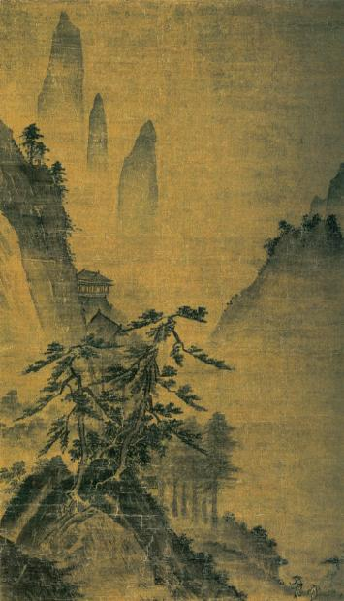
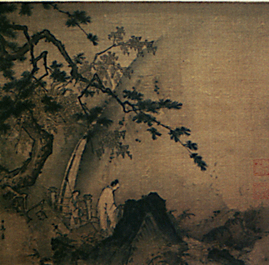
Ma Yuan, Hangzhou (Hangchow)

Slide 4
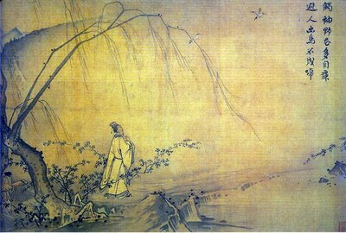

Slide 5
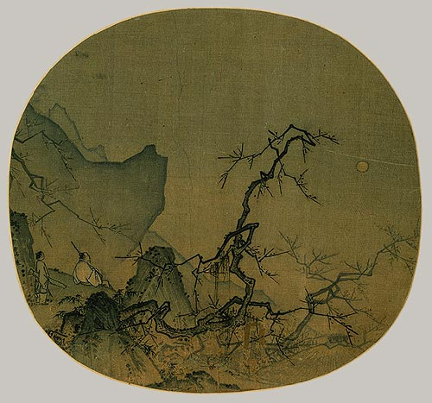

Slide 6
Yuan Dynasty
1279-1368 CE

Slide 7
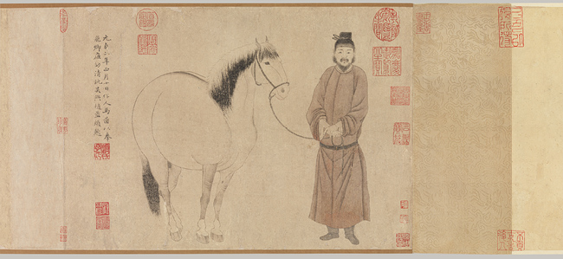
Groom and Horse, Zhao Mengfu

Slide 8
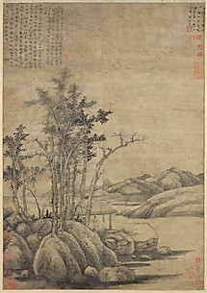
Woods and Valleys of Mount Yu, Ni Zan

Slide 9
Ming Dynasty
1368-1644 CE

Slide 10
Autumn Mountains, Dong Qichang

Slide 11
Autumn Mountains, Dong Qichang

Slide 12
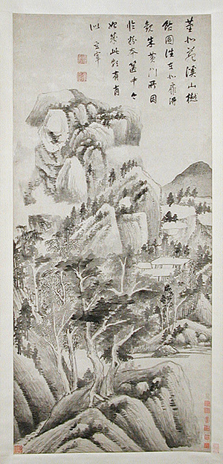

Slide 13
Qing Dynasty
1644-1911 CE

Slide 14
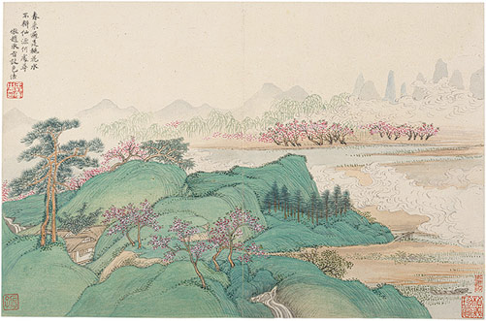
Landscape after Ancient Masters, Wang Hui

Slide 15
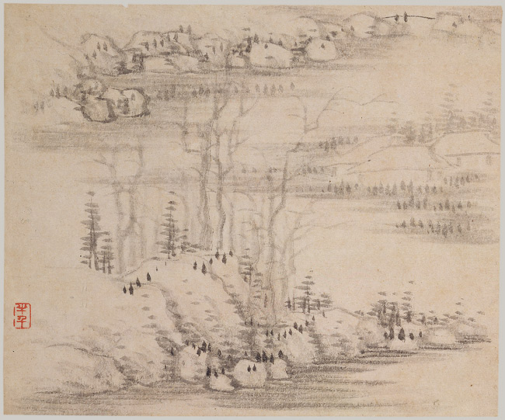
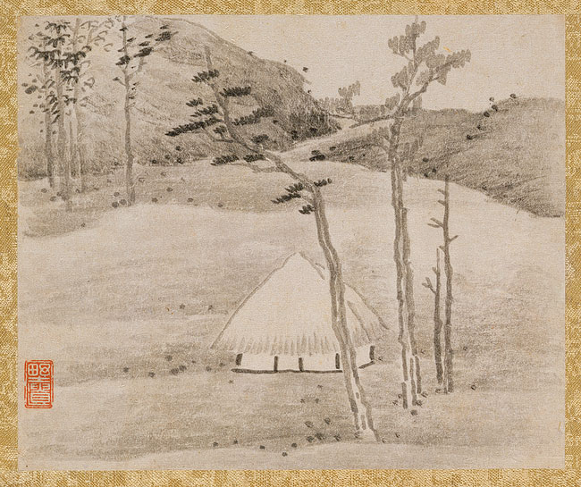
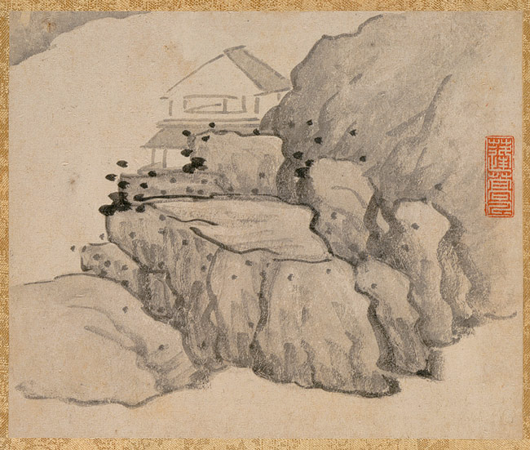
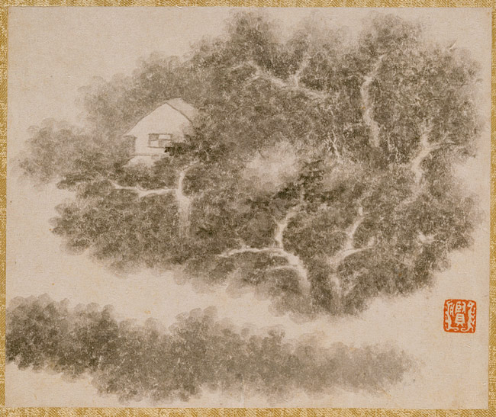
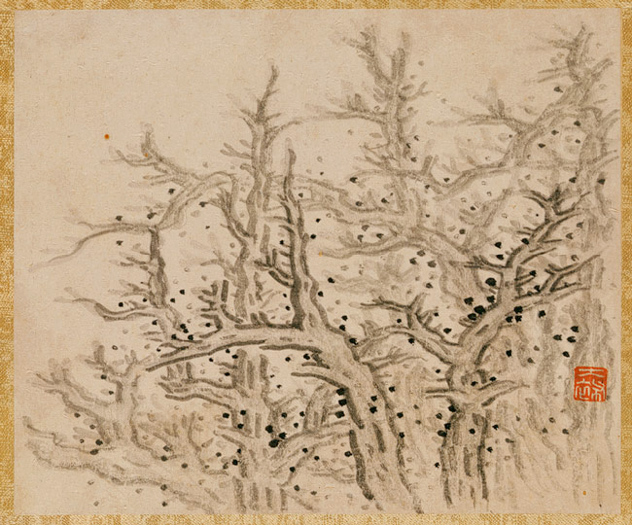
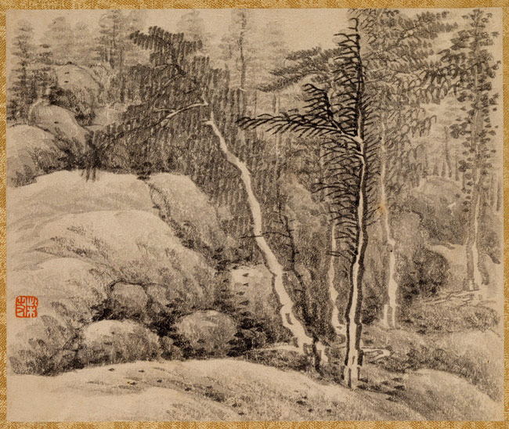
Landscape and Trees Gong Xian

Slide 16
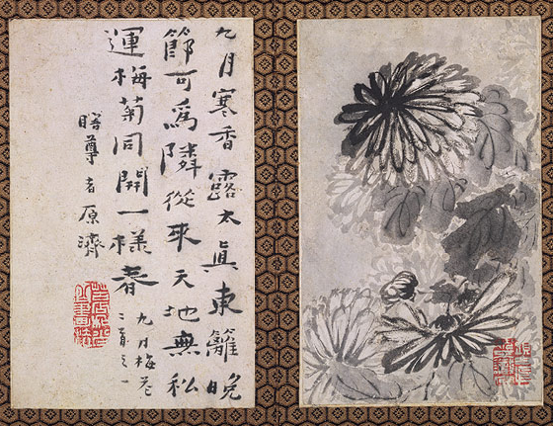
Returning Home, Shitao (Zhu Ruoji)

Slide 17
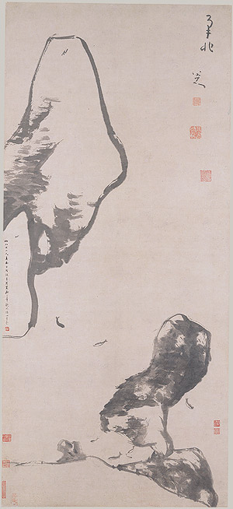
Fish and Rocks, Bada Shanren (Zhu Da)
FISH

Slide 18
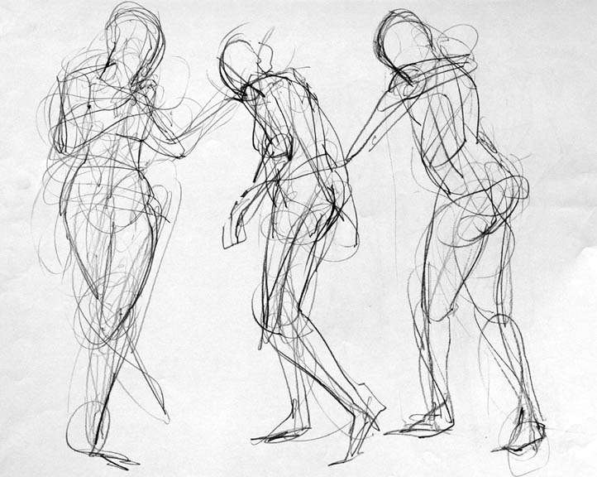
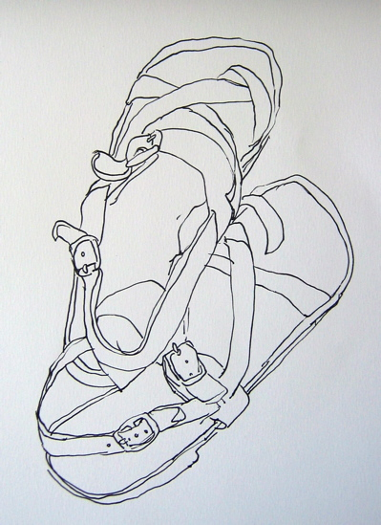
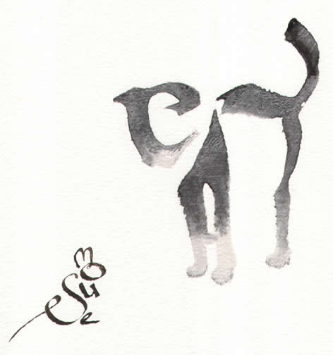
Drawing with Line
Contour
The outline of an
object’s edges.
Calligraphy
Flowing lines
which change
from thin to
thick.
Gesture Line
Many rapidly drawn
lines of a subject to capture movement.

Slide 19
Basic Brush strokes
Bands of Color
Thick ‘n’ Thin
Wrist Flick
Painterly Strokes
The Stab
Cutting Edges

Slide 20
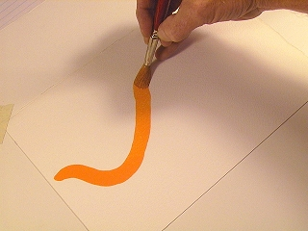
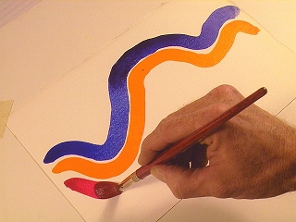
Bands of Color

Slide 21
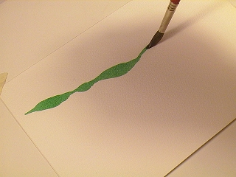
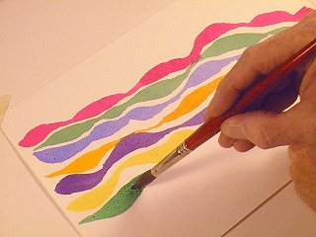
Thick ‘n’ Thin

Slide 22
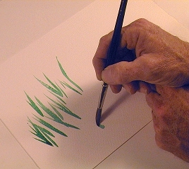
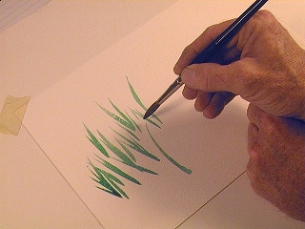
Wrist Flick

Slide 23
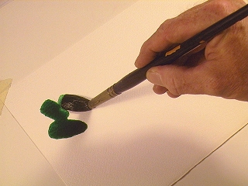
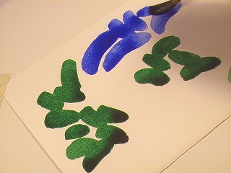
Painterly Strokes

Slide 24
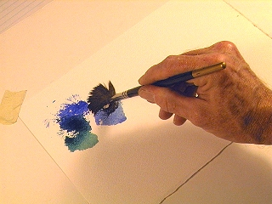
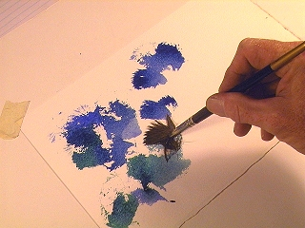
The Stab

Slide 25
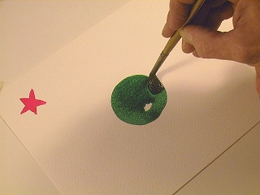
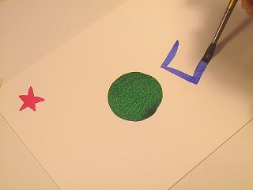
Cutting Edges

Slide 26
Credits
http://www.watercolorpainting.com/brush_exercise_thickthin.htm

Slide 27
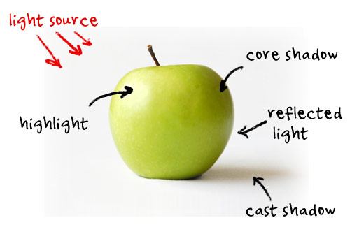
Anatomy of Light and Shadow

