Slide 1
Talk with Your Hands
Ms. Stockbridge

Slide 2
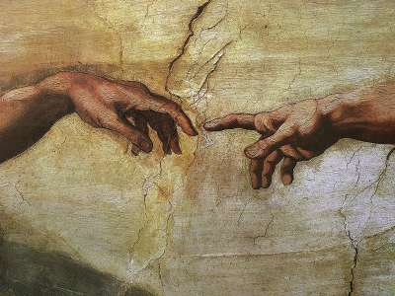

Slide 3
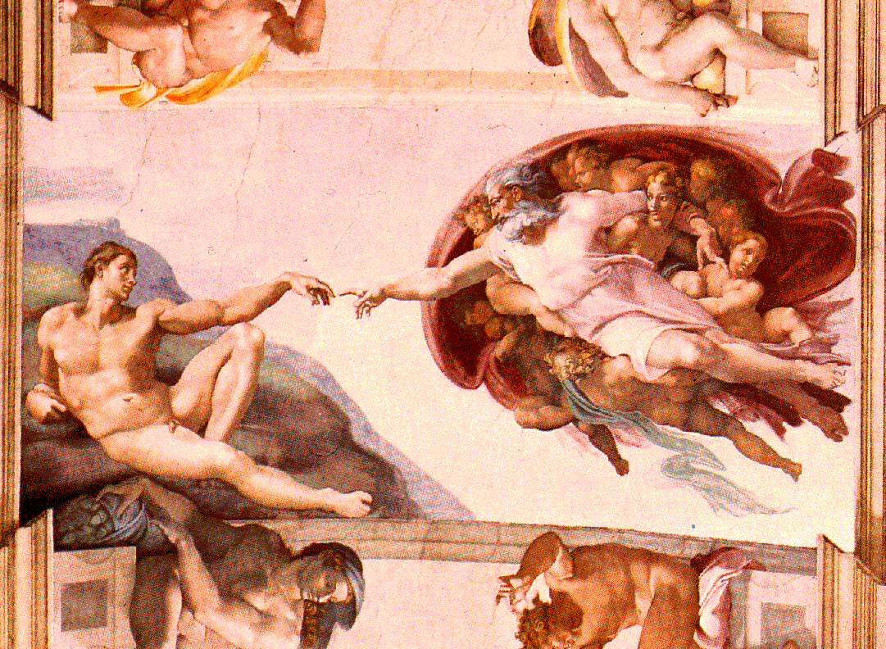

Slide 4
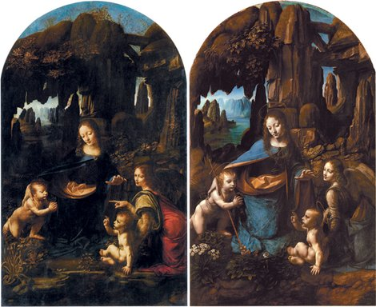

Slide 5
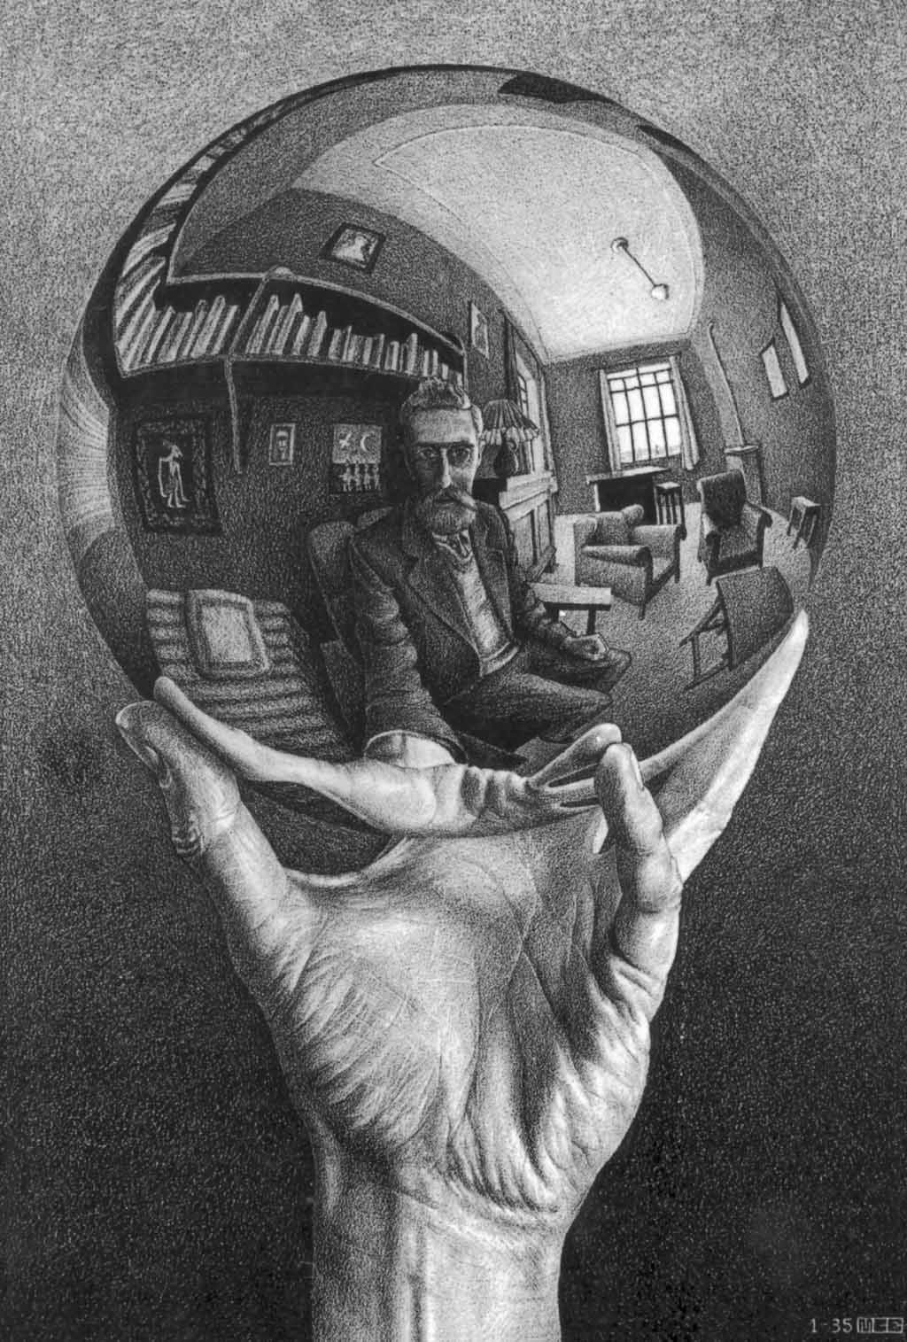

Slide 6
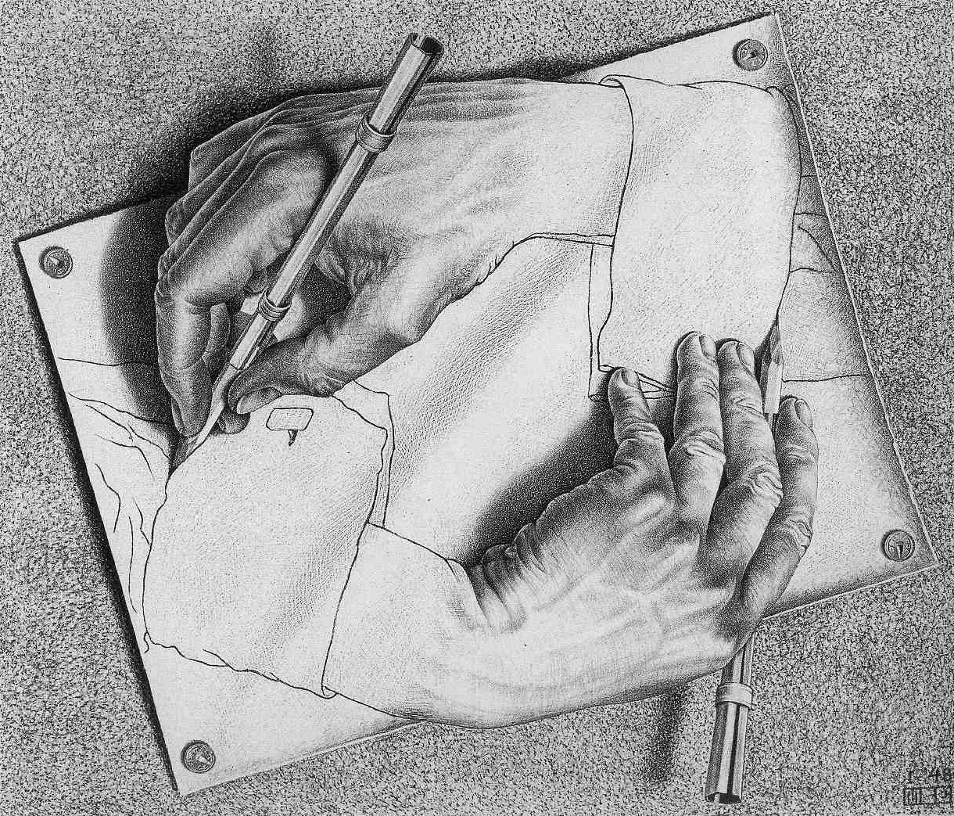

Slide 7
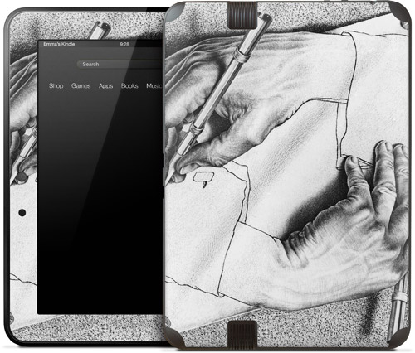
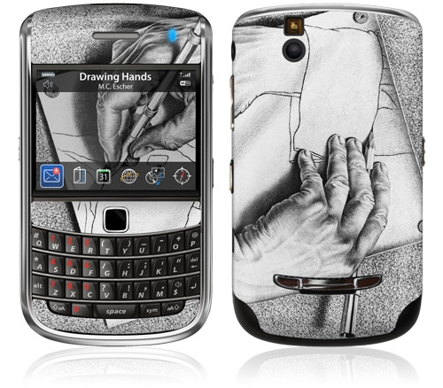
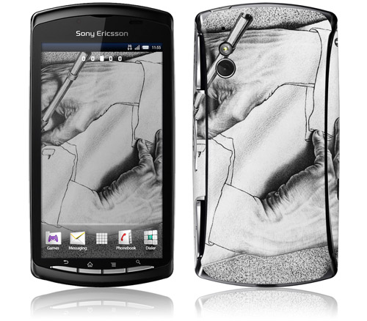

Slide 8
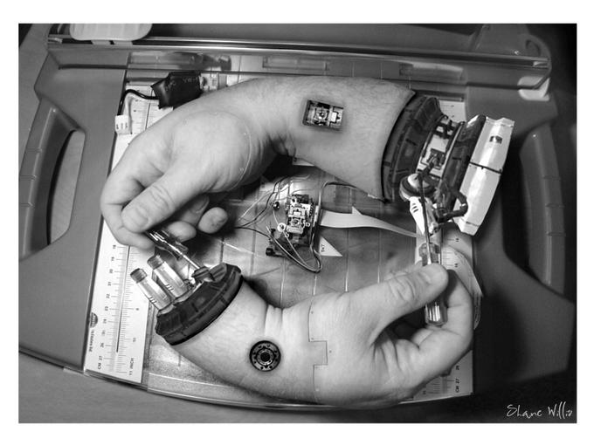

Slide 9
Does it make you think and emotion or tell a story?
Can you explain why?
Ask a friend to help refine idea to make it more obvious?
Find new idea
Is it just hands & 1 object?
Is it interesting to look at?
Brainstorm Together to make interesting- off center, change viewpoint.
See Me
Start Final Copy
YAY!
= No
= Yes

